Slide 1
Vegas.Com Assessment on Employee Data
By Gavin Gunawardena
2/20/2023
Code: https://nbviewer.org/github/ggunaward/Misc/blob/main/Vegas.com%20Assessment%20Code%20Gavin%20Gunawardena.ipynb

Slide 2
Objective
Objective
Look for insights in the employee data
Find some justifiable recommendations
Assumptions
Data may not be clean
Data is current

Slide 3
Initial Plan
A couple of variables were chosen to inspect that may help the business
Job Satisfaction (JobSatisfaction)
Turnover Rate (YearsAtCompany)
Exploratory Analysis
Compare the chosen variables with numeric variables in the dataset to decide on what to focus on based on which of the chosen variables have stronger correlations with the numeric variables
Numeric variables are scaled for better comparison via visualization and more accurate data modeling
Min-max scaling was used, utilizing the minimum and maximum value of each numeric variable to set their values between 0 and 1.
Numeric variables were also grouped and aggregated by mean for the visualizations
Trend Analysis
Ridge Regression
Linear regression with a penalty term to minimize coefficients that have the least correlation with the target variable, improving model fit by increasing bias but decreasing variance compared to regular linear regression
Chosen as it is commonly used in many industries due to being simple and not a black box (it’s easy to showcase inner workings)
Combats common issues in datasets like multicollinearity (target variables being correlated with each other), but more importantly helps narrow down variables to those with the strongest correlations to the target variables

Slide 4
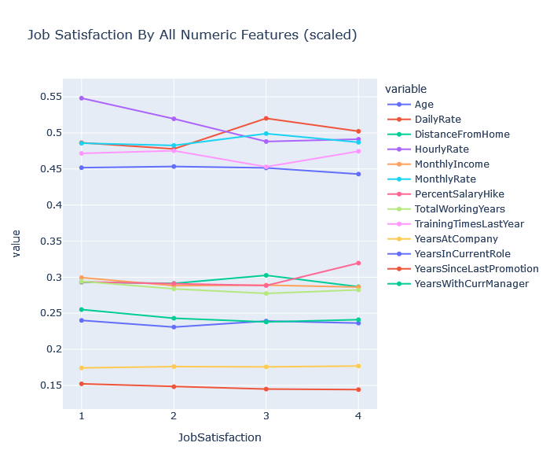
Exploratory Analysis 1
“Job satisfaction” data does not have strong correlations with any of the numeric variables
Interactive chart link: https://plotly.com/~ggunaward/1/
Note: Numeric variables are scaled here. Please see slide 3 for details

Slide 5
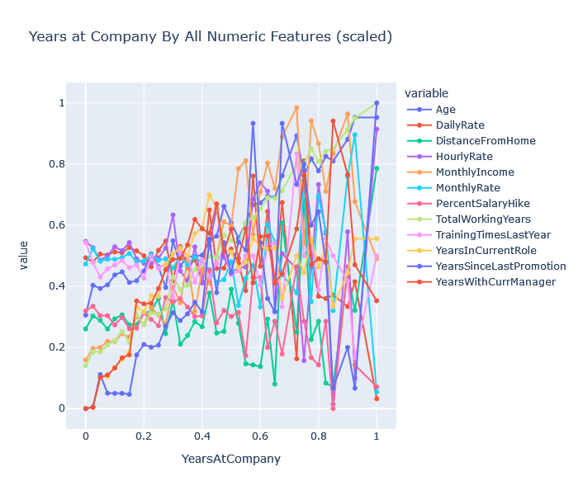
Exploratory Analysis 2
“Years at Company” has strong correlations with other numeric variables, but also a lot more noise
Interactive chart link: https://chart-studio.plotly.com/~ggunaward/3/#/
Note: Numeric variables are scaled here. Please see slide 3 for details

Slide 6
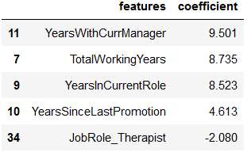
Ridge Regression Results
Due to the strong correlations found in the exploratory analysis of turnover rate (YearsAtCompany), the ridge regression results will be focused on this
Factors effecting Turnover Rate
Years with current manager (strong positive correlation)
Total working years (strong positive correlation)
Years in current role (strong positive correlation)
Years since last promotion (medium positive correlation)
Job Role = Therapist (minor negative correlation)
Raw Results

Slide 7
Conclusions
Improvements can be made to turnover rates for the company by:
Increasing years with current managers
Slowing down how quickly roles are changed and promotions are given
Improving working conditions or benefits for therapists working for the company

